Slide 1

Welcome
Notes:
Topic: COSFA
Time: 30 minutes
Purpose of training evolution: To build Warrior Toughness, Sailors will learn skills and support necessary to aid shipmates during stress-related injury to mitigate destructive behaviors.
Expected outcome of training evolution: All hands preserve life, prevent harm, and promote recovery.
Safety: Inform Sailors of safety hazards in the training environment. For some topics, Sailors should be informed if there is a designated person to talk to if the Sailor feels compelled to leave the training.
Facilitator Actions:
Display slide.
Greet Sailors.
Introduce yourself and give any background on yourself that might be of interest.
Establish credibility.
Facilitator Instructions:
The slide deck acts as a guide to present a facilitated discussion that may include activities.
Best practice: Use the slide to develop interest in the subject matter. Do not read the slides word for word. The Sailors should be able read the text and understand the messaging presented in the graphics.
Facilitator notes are available for each slide to help the Facilitator deliver the topic.
Best practice: Use the Slide Show view to ensure the Facilitator notes are viewable.
The Facilitator notes are divided into general instructions for Facilitator Actions (mechanics of facilitation) and the Facilitator Content (Inform, Discuss, Perform, and Reference).
Best practice for Inform: Present facts, concepts, and procedures. Depending on the facilitator’s expertise, content may be used as background information or suggested talking points. Content in quotation marks is recommended to be read verbatim.
Best practice for Discuss: Conduct large-group question and answer sessions or large-group, Facilitator-led activities. Depending on the subject matter, these may be written as questions with expected answers or scripted activities.
Best practice for Perform: Facilitate small-group, scenario-based or procedural activities. Depending on the subject matter, these may be written with specific actions the Sailors will take or general ways for the Facilitator to monitor the activities. The Facilitator will be provided with expected outcomes to ensure Sailors leave training with correct information.
Best practice for Reference: This is for Facilitator use only.

Slide 2
Introduction
Warrior Toughness
MIND • BODY • SPIRIT
Combat and Operational Stress First Aid (COSFA)
Notes:
Facilitator Actions:
Display slide.
Introduce topic.
Let Sailors know that they can leave the discussion if they have to for their own well-being.
Ensure that misinformation is corrected immediately.
Monitor the discussions of the Sailors throughout the training event.
Facilitator Content:
Inform:
To build Warrior Toughness, Sailors will learn skills and support necessary to aid shipmates during stress-related injury to mitigate destructive behaviors.
Expected outcome of training evolution: All hands preserve life, prevent harm, and promote recovery.

Slide 3
Learning Objective
Use COSFA skills to preserve life, prevent harm, and promote recovery.
Notes:
Facilitator Actions:
Display slide.
Neither Sailors nor Facilitator should read the objective out loud.
Facilitator Content: N/A

Slide 4

COSFA
"Every U.S. Navy Sailor, enlisted or officer, could face life-threatening situations from combat or casualty. Each and every one needs to have the ability to persevere and perform under both immediate danger and long-term stress, both on the job and at home.“
- U.S. Navy, "Warrior Toughness," Naval Education and Training Command
Notes:
Facilitator Actions:
Display slide.
Discuss how graphic relates to topic.
Monitor the discussions of the Sailors.
Facilitator Content:
Discuss:
Have you heard the term COSFA before?
What do you think COSFA is?
Inform:
COSFA is a multistep process for assessing and providing peer support for yellow and orange zone stress reactions or injuries to individuals or units. It involves quick and accurate assessments, identifies specific needs, and determines when additional treatment is required to ensure prompt treatment.
Discuss:
How do you think COSFA impacts your community?

Slide 5
Stress Continuum
Not Engaged | Ready | Reacting | Injured | Ill
Disinterested Unmotivated Unfocused No initiative Unproductive Limited involvement in work relationships | Good to go Well trained Fit and focused Connected Accepting new challenges Active coping Effectively Manages stress | Quick temper Irritable Diminished self-control Poor focus Poor sleep Temporary & transitory Needed for growth Withdrawing from usual social activities | Serious or significant distress or impairment due to: W.I.L.T. (i.e., Wear & Tear, Inner Conflict, Loss, & Life Threat) Overwhelming emotions Insomnia, nightmares Breaking relationships Shame, guilt Destructive behavior | Stress injuries that don’t heal without help Diagnosable mental health and substance use disorders
LEADERSHIP OPPORTUNITY | OPTIMAL PERFORMANCE | SELF-CARE OPPORTUNITY | POINT OF INTERVENTION | RECOVERS WITH EFFECTIVE CARE & REINTEGRATION
Unit Leader Responsibility |  | Individual, Shipmate, Family Responsibility |  | Caregiver Responsibility
NOT ENGAGED
READY
REACTING
INJURED
ILL
Notes:
Facilitator Actions:
Display slide.
Discuss how graphic relates to topic.
Monitor the discussions of the Sailors.
Facilitator Content:
Discuss
What color range do you feel like you function in daily?
Have you ever experienced a fellow Sailor in the orange zone? What happened?
Inform:
COSFA is intended to assist you and others in advancing toward the stress continuum's green, ready zone.
Similar to first aid for physical wounds and diseases, stress first aid is a collection of tools with three objectives:
Preserve life.
Prevent further harm.
Promote recovery.
Discuss:
How would you help Sailors get out of the blue zone?
What does it mean if a Sailor is in the yellow zone?
Inform:
The Combat and Operational Stress Continuum Model serves as the foundation to determine the following:
Evaluate how a Sailor is currently functioning and what level of stress they have reached.
Evaluate if the Sailor is a danger to themselves or others.
Determine if you need to get immediate help for the Sailor.
Provide a supportive environment when the Sailor returns to duty.
It is important to be able to recognize if a fellow Sailor in need of help still needs assistance and is in the yellow or orange zone.
Discuss:
If a Sailor is in the yellow zone, does that mean they are in danger?
How could a Sailor progress from the yellow to orange zone?
What does it mean if a Sailor is in the orange zone?
Inform:
It is possible for certain stress reactions to be postponed or to resurface weeks or months later.
It is crucial to realize that COSFA helps Sailors get back into the green zone of ready.
As Sailors resume their missions and personal preparedness, it is important to keep checking and coordinating by providing continuous aid.
Discuss:
How does prolonged stress influence a Sailor’s ability to be resilient in the face of adversity?
How can you tell if a fellow Sailor is suffering from a stress injury?
What objectives of COSFA do you think stress first aid aims to achieve? (Answer: preserve life, prevent further harm, and promote recovery)
How can understanding the stress continuum improve the effectiveness of stress first aid interventions and recovery?

Slide 6


Reacting Versus Injured
What is the difference between reacting and being injured?
Reacting
Injured
Notes:
Facilitator Actions:
Display slide.
Discuss how graphics relate to topic.
Monitor the discussions of the Sailors.
Facilitator Content:
Discuss:
What is the difference between reacting and being injured? (Answer should include: The main difference between reacting and being injured is the amount of control and impact. Reacting is a normal response to stress; however, injury shows as a more severe disruption of emotional or mental health requiring help.)
Inform:
It is crucial to recognize when a fellow Sailor is hurt or reacting.
A leader cannot lead effectively if they do not check in on their Sailors.
Peer support can be an effective method to reducing stress injury.
Recognizing and responding to these warning signs early on can help avert an escalation.
Discuss:
What are a few signs that a Sailor is suffering from elevated levels of stress?
Inform:
When someone reacts, they are exhibiting a typical stress response. This stage shows tolerable stress, but the symptoms should not be disregarded because they may worsen if not addressed.
Common signs of reacting include:
Feeling anxious or irritated
Worrying constantly
Taking shortcuts on the job or ignoring responsibilities
Having a short-tempered, rude, or grumpy demeanor
Having trouble sleeping or eating
Refusing to interact with others or remaining alone
Discuss:
What are a few signs that a Sailor is suffering from a stress injury?
Inform:
Being injured suggests that stress has become more severe, causing considerable disruption to a Sailor’s mental, emotional, or physical well-being.
These symptoms indicate a loss of control and demand immediate attention.
Common signs of being injured include:
Loss of control over bodily functions, emotions, or thoughts
Inability to fall or remain asleep and recurrent, vivid nightmares
Intense guilt or shame that is overwhelming
Panic attacks or rage
Inability to enjoy previously pleasurable activities
Serious suicidal or homicidal thoughts
Discuss:
How can you tell if a Sailor needs immediate assistance?
Inform:
Responding is a typical reaction to stress, but harm indicates a more significant disruption of emotional or mental health, requiring expert assistance from a mental health professional, Chaplain, or medical provider.
Additionally, Sailors who are in the yellow level may require less assistance to return to green.
If a Sailor reaches stress levels of orange to red, they require immediate additional assistance.

Slide 7
Sources of Stress Injury
NOT ENGAGED
READY
REACTING
INJURED
ILL
Wear and Tear
Inner Conflict
Loss
Life Threat
A fatigue injury
Accumulation of all stress over time
An ethical, moral, betrayal injury
Violation of deeply held beliefs
A grief injury
Loss of cherished people or things
Serious injury
Close brush with death
Notes:
Facilitator Actions:
Display slide.
Discuss how graphic relates to topic.
Monitor the discussions of the Sailors.
Facilitator Content:
Discuss:
Have you lost a friend or family member in the last few years?
How long did it take to recover from the feeling of loss?
Inform:
Leaders and peers must listen and look for the internal factors that lead to a stress injury.
The four sources of stress injury include:
Wear and tear
Exhaustion and buildup of prolonged stress
Inadequate rest, sleep, or restoration
Inner conflict or moral injury
Damage caused by a conflict between moral or ethical convictions and current events
Actions performed outside of the rules of engagement
Clash between one's own morality and ethics
Loss
Feeling of grief caused by the death of close comrades, leaders, family members, or other cared-for individuals
Feeling of grief caused by the loss of a relationship
Life threat
Experiencing life-threatening events that cause fear, horror, or helplessness
Seeing someone die or get hurt
Discuss:
How do you perform if you don’t get enough sleep?
How does a prolonged stress injury affect a Sailor’s resilience?

Slide 8
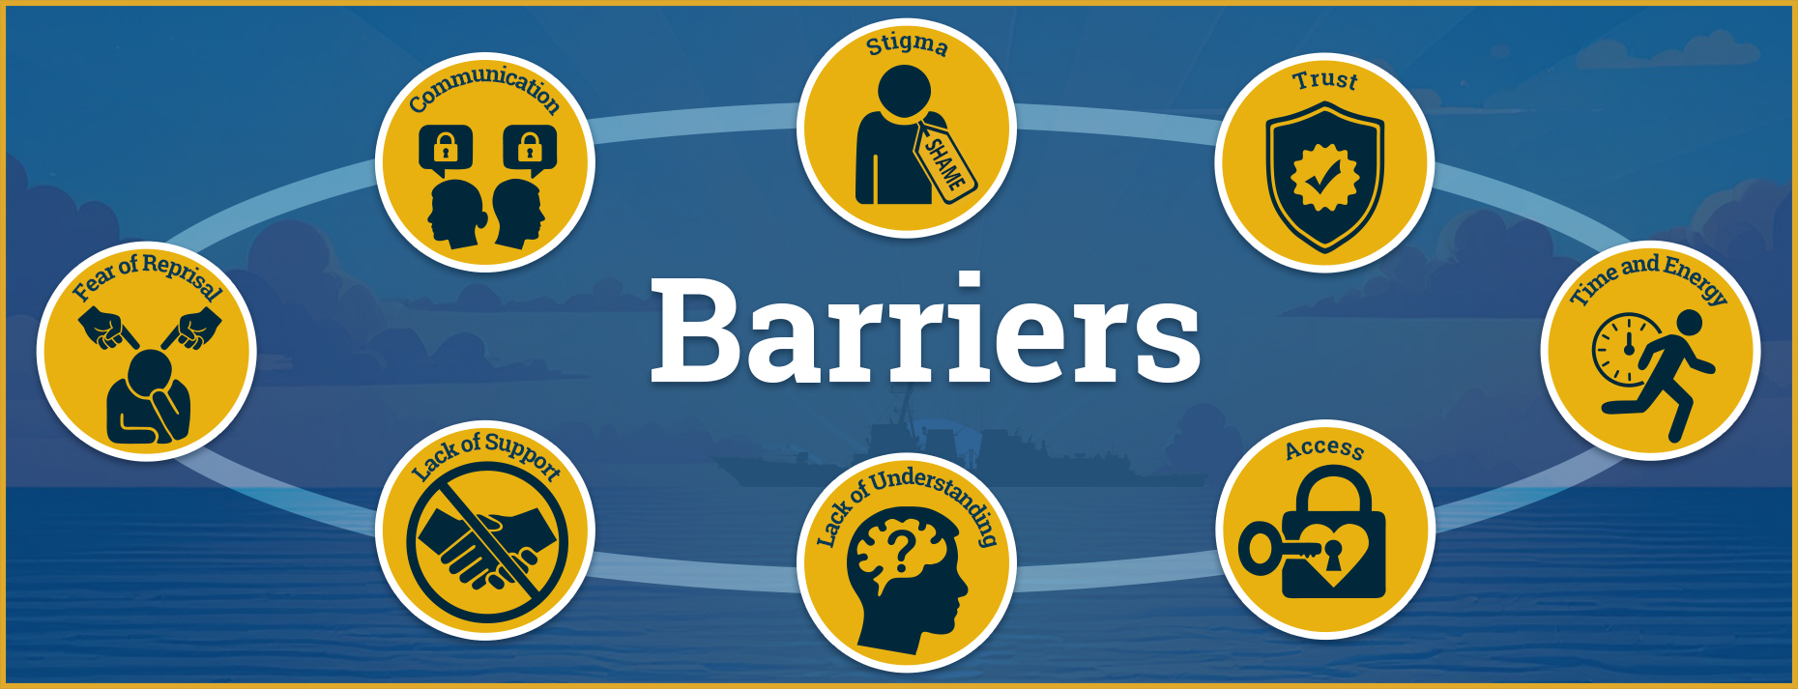
Barriers to Addressing Stress
Any one of these barriers can delay or prevent individuals from getting the appropriate care they need.
Barriers to Addressing Stress
Notes:
Facilitator Actions:
Display slide.
Discuss how graphic relates to topic.
Monitor the discussions of the Sailors.
Facilitator Content:
Discuss:
What types of barriers keep Sailors from asking for help?
How can barriers delay or prevent Sailors from seeking help?
Inform:
The following are examples of barriers you may encounter:
Stigma: false impressions connected with seeking help for stress injuries
Trust: not feeling comfortable enough to open up and discuss
Time and energy: no time or energy left to talk to someone for help
Access: thinking care is limited or are unsure of how to obtain it
Lack of understanding: limited knowledge of mental illness and not realizing the need for help
Lack of support: issues being dismissed or minimized
Fear of reprisal: thinking negative repercussions will result
Communication: not knowing how to talk about issues with leaders and peers
Discuss:
How can we overcome these barriers?
Inform:
Seeking and asking for assistance is normal. It is acceptable and encouraged to seek assistance in times of difficulty.
Bottling up emotions is dangerous because the energy will eventually be unleashed and can be harmful if not handled properly.
Without adequate direction or assistance, any injury or illness can, and will, worsen before improving.
Mental Health Playbook encourages understanding the signs and symptoms, creating a secure atmosphere, and fostering a positive culture that encourages Sailors to seek treatment and makes it acceptable to intervene and engage.

Slide 9
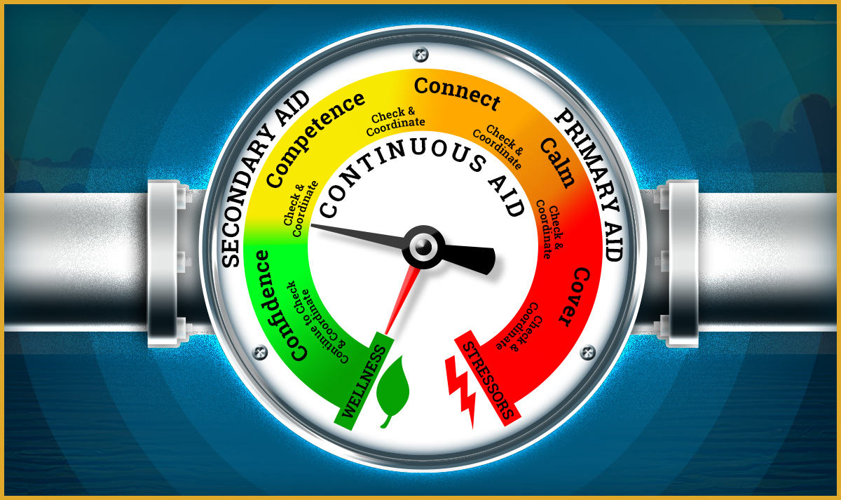
Levels of Aid
Levels are:
Primary aid
Secondary aid
Continuous aid
Notes:
Facilitator Actions:
Display slide.
Discuss how graphic relates to topic.
Monitor the discussions of the Sailors.
Facilitator Content:
Inform:
COSFA consists of seven core actions grouped within three levels.
The three stages of aid are not always linear.
Discuss:
Have you ever checked up on a buddy that was struggling?
Did you continue to check up on them?
Did they get better or worse?
Inform:
After observing a Sailor in distress, it may be necessary to provide immediate primary aid to ensure the Sailor’s safety.
Primary aid:
Ensures the Sailor’s safety and those around them
Prevents further harm from happening
Provides an immediate crisis response
Allows the healing process to begin
Failing to identify and provide primary aid may result in injury or loss of life.
Discuss:
Have you ever helped a fellow Sailor recover from a stress injury?
What did you say or do to help them?
Inform:
Secondary aid is provided after primary aid when immediate danger has passed, to help process emotions and begin recovery.
Secondary aid:
Focuses on long-term mental, physical, spiritual, and social recovery
Uses military and family resources to restore wellness and green zone functionality
Failing to provide secondary aid can cause a Sailor to slide from the green or yellow zone into the orange or red zone.
Discuss:
How would you react if you discovered you were the last person a friend or family member talked to before they were involved in a tragedy?
Inform:
By regularly checking up on a fellow Sailor that has been dealing with a lot of stress you are providing continuous aid.
Continuous aid:
Ensures that stress-related issues are monitored and addressed as they evolve
Provides ongoing support
Failing to provide continuous aid can cause a Sailor to slide from the green or yellow zone into the orange or red zone.
Discuss:
Have you ever been in a situation that made you worried about the safety of a friend or family member?
What did you do to help them?
What would you do if you were in a workshop and a Sailor threw a wrench in anger and almost hit someone?

Slide 10
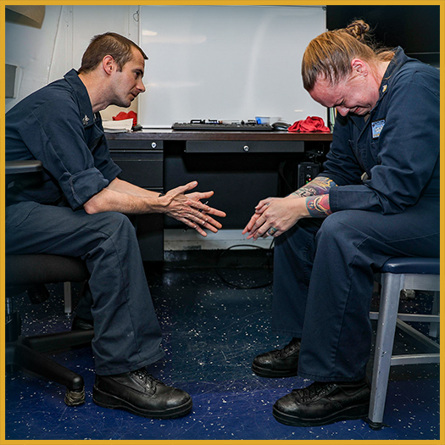
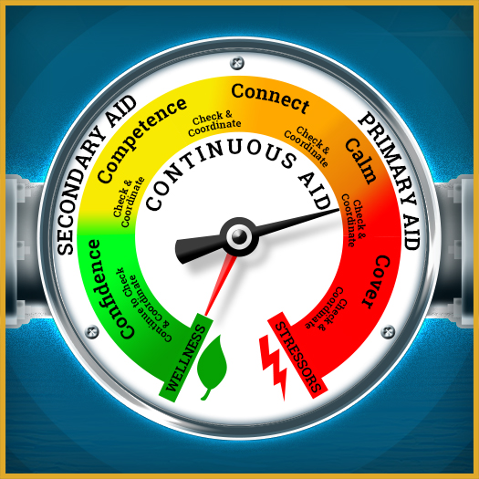
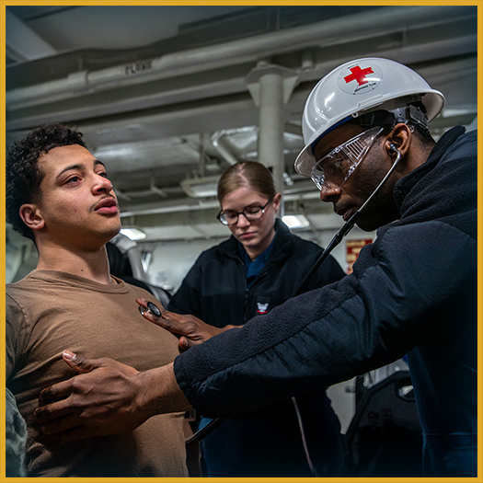
Primary Aid
What is primary aid?
Notes:
Facilitator Actions:
Display slide.
Discuss how graphics relate to topic.
Monitor the discussions of the Sailors.
Facilitator Content:
Discuss:
What is primary aid?
Inform:
Primary aid ensures the Sailor’s safety, the safety of those around them, and prevents further harm from happening.
Primary aid consists of the two essential components of cover and calm.
Discuss:
Have you ever provided primary aid for a fellow Sailor?
What does cover mean?
Inform:
Cover is getting a Sailor to physical safety as quickly as possible. An easy way to remember this is the term, “Take cover!”
Stress can impair the ability to recognize danger and react, so it is important to act when others cannot.
The cover process includes:
Ensuring immediate safety for the stress-affected individual and others
Shielding from further stress
Protecting others
Establishing a secure environment
Nonverbal and verbal cover techniques can be used to assist in getting a Sailor to cover.
Discuss:
Why is it important to get a Sailor to cover when they are in distress?
How would you get a fellow Sailor to cover if they were in an abusive situation?
What does calm mean?
Inform:
Calm helps restore normal functioning by using energy management to reduce muscle tension, heart rate, and emotional intensity, aiding both physical and mental recovery.
The calm process includes:
Reducing level of emotional intensity
Listening empathetically as the Sailor shares their experience
Focusing on regaining mental clarity and emotional control
Nonverbal and verbal calming techniques can be used to assist in calming a Sailor in distress.
Discuss:
Why is it important to help calm a Sailor that is in distress?

Slide 11
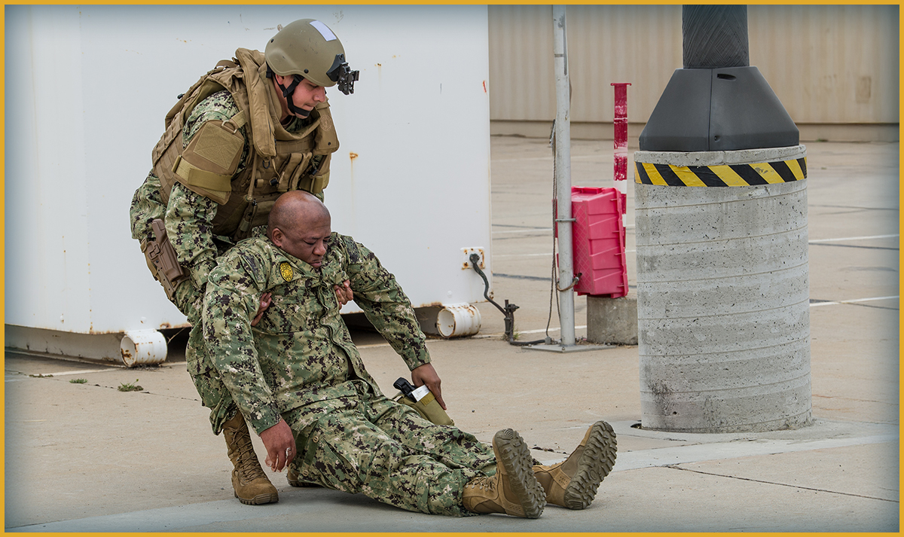
Cover Techniques
Ensure safety quickly.
Notes:
Facilitator Actions:
Display slide.
Discuss how graphic relates to topic.
Monitor the discussions of the Sailors.
Facilitator Content:
Discuss:
How do you get a Sailor into cover?
Inform:
When a Sailor is in danger, it is important to get them to cover as quickly as possible. This can be achieved using nonverbal cover and verbal cover techniques.
Discuss:
What do you think examples of nonverbal cover techniques are?
Inform:
Nonverbal cover techniques can include:
Making eye contact with the Sailor while indicating stop with your own hands
Gently pushing one hand on a Sailor’s arm or neck, shaking them, or prodding them to get their attention
Blocking a Sailor’s way or physically restraining them
Taking physical control of the Sailor’s body and pulling them to safety
Discuss:
What do you think examples of verbal cover techniques are?
Inform:
Verbal cover techniques can include:
Finding out if the Sailor is alright or needs assistance
Sharing your observations with the Sailor and offering a safer alternative
Alerting the Sailor of the danger that is about to happen
Giving the Sailor a firm order to cease
Discuss:
How would you determine if nonverbal cover or verbal cover techniques are necessary?
Inform:
In the moment, it may be difficult to decide the best course of action to get a fellow Sailor to cover.
Potential obstacles to cover and mobilize resources to overcome can include:
Being completely focused on addressing your personal dangers and prioritizing your own safety before helping others
Involving leaders, peers, medical professionals, Chaplains, or family members if you cannot win or maintain the trust and attention of an orange zone Sailor
Seeking medical attention, treatment, etc., when the Sailor in the orange zone continues to be dangerously agitated even after being covered
Discuss:
Have you ever been in a situation where it was necessary to cover a fellow Sailor? If so, how did you do it?

Slide 12
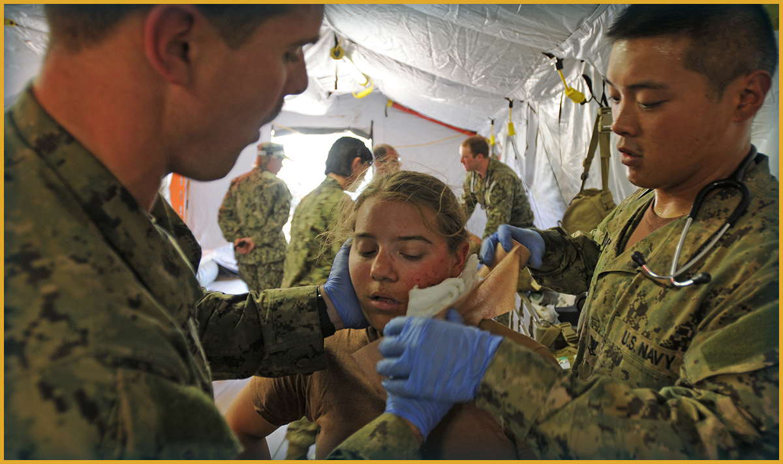
Calm Techniques
Remain calm and authoritative.
Notes:
Facilitator Actions:
Display slide.
Discuss how graphic relates to topic.
Monitor the discussions of the Sailors.
Facilitator Content:
Discuss:
How do you calm a Sailor when they are in distress?
What is a nonverbal calming technique?
Inform:
Nonverbal calming techniques are used to communicate with a Sailor in distress without talking to them.
Nonverbal calming techniques can include:
Having a dominant physical presence, remaining composed, and maintaining eye contact with the Sailor
Not showing anger, fear, disgust, or annoyance with the Sailor in need
Touching or holding the Sailor when appropriate and non-threatening
Discuss:
How can you tell if the nonverbal calming technique is working?
What are other ways you can nonverbally calm a Sailor when they are in distress?
What is the difference between a nonverbal and verbal calming technique?
Inform:
Verbal calming techniques are ways to directly communicate with a Sailor in distress to de-escalate the situation to help them calm down.
Verbal calming techniques can include:
Grabbing attention using commands such as "Listen to my voice!" or "Look at me!“
Soothing phrases that can be repeated to the Sailor such as:
"It is okay.“
"Easy now.“
"I am here with you.“
"You are safe now."
“Just breathe.”
Using encouraging statements such as "There you go" or "You can do it“ when the Sailor starts to make progress out of their distressed state
Suggesting they perform recalibrated breathing techniques
“Breathe in for 5 seconds through your nose, and out through your mouth for 7 seconds.”
Diverting their attention by asking them questions not related to the source of their distress
Empathetically hearing distressing recollections, feelings, or ideas from the Sailor when they respond to you
Discuss:
How can you tell if the verbal calming technique is working?
What are other ways you can verbally calm a Sailor when they are in distress?
What are some of the potential obstacles to calming a Sailor in distress?
Inform:
There may be potential obstacles in your way that must be overcome before you can assist a fellow Sailor in distress.
Potential obstacles to calm and mobilize resources for a Sailor in distress can include:
Not being calm and unable to employ calming techniques on both yourself and the other person at the same time
Calm yourself before attempting to calm others.
Being too engaged with other tasks or busy to assist the Sailor
Ask for help from others to allow yourself enough time to help your fellow Sailor.
Being surrounded by too much noise or shouting individuals
Find a place that is safer and quieter and move to that location.
If verbal and nonverbal techniques fail to calm the Sailor in the orange zone, seek medical attention.
Discuss:
Have you ever helped to calm a Sailor when they are in distress? What actions did you take?
Has anyone helped you calm down when you were in need? What did they do to help?

Slide 13

Check Tools for Communication
Why is effective communication an essential component of COSFA?
O
BSERVE
Actively observe behaviors; look for patterns.
S
TATE OBSERVATION
Address behaviors only, just the facts without interpretations or judgements.
C
LARIFY ROLE
State why you are concerned about the behavior. This validates why you are addressing the issue.
A
SK WHY
Seek clarification; try to understand the other person’s perception of the behavior.
R
ESPOND
Clarify concern if indicated. Discuss desired behaviors. State options in behavioral terms.
Notes:
Facilitator Actions:
Display slide.
Discuss how graphic relates to topic.
Monitor the discussions of the Sailors.
Facilitator Content:
Discuss:
What is the Observe, State, Clarify, Ask, Respond (OSCAR) Communication Model?
Inform:
The OSCAR Communication Model helps identify stressors in the yellow or orange zones and provides insight into the Sailor’s conduct.
The OSCAR Communication Model is used to encourage conversation with questions such as:
Do you feel comfortable discussing what is happening?
What concerns or experiences do you have?
What should happen next, in your opinion?
It’s important to actively listen to understand, not just to respond, and to show empathy by considering the Sailor’s point of view.
Understanding can be demonstrated through supportive nonverbal cues such as head nods or warm facial expressions.
Sometimes, simply listening and validating the Sailor’s frustrations promotes openness and engagement.
When using the OSCAR Communication Model, ensure to do the following:
Identify areas that need help and connect the Sailor to available resources, both internal and local.
Always obtain consent before sharing information with the chain of command and clarify what needs to be reported.
Ensure the Sailor remains connected to resources, follows through on their action plan, and stays on track with recovery. Continuous peer support is essential.
This model fosters a supportive, empathetic environment that encourages candid conversations and ensures the Sailor receives the necessary care.
Discuss:
How could the OSCAR Communication Model be used to assist fellow Sailors when talking to them about problems or concerns?
Why is effective communication an essential component of COSFA? (Answer: Effective communication is crucial in COSFA because it helps accurately identify stressors in the yellow or orange zones and provides valuable insights into a Sailor’s personal conduct, enabling timely and appropriate support.)

Slide 14

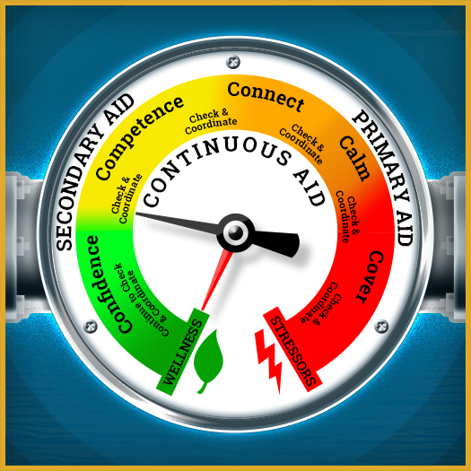
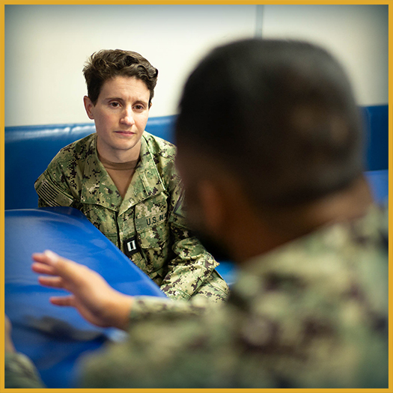
Secondary Aid
What is secondary aid?
Notes:
Facilitator Actions:
Display slide.
Discuss how graphics relate to topic.
Monitor the discussions of the Sailors.
Facilitator Content:
Discuss:
What is secondary aid?
Inform:
Secondary aid is provided after primary aid when immediate danger has passed, to help process emotions and begin recovery.
Secondary aid consists of three essential components: connect, competence, and confidence.
Discuss:
Have you ever provided secondary aid to a fellow Sailor?
What is the connect process?
Inform:
The connect process facilitates access to major support systems, like friends and family, and removes barriers to social support.
The connect process is used to:
Encourage constructive peer support and prevent social withdrawal due to stress.
Help Sailors reconnect with trusted people to feel valued, share experiences, and regain predictability after yellow or orange zone stress injuries.
Provide support and connection when stress results in the following:
Feelings of isolation and loss of trust
Difficulty expressing emotions
Avoiding uncomfortable conversations due to fear of stigma
Discuss:
How can connecting with other Sailors when they’re in the yellow zone help prevent them from entering the orange zone?
Has anyone reached out to you in the past when you were healing from a stress injury?
What impact did it have on your recovery?
What is the competence process?
Inform:
The competence process helps to restore previous skills, functionality, and mental and physical capabilities within a Sailor.
The competence process is used to:
Collaborate with leaders to facilitate appropriate roles and retraining.
Encourage gradual re-exposure to feared situations.
Indicators for lack of competence include:
Loss of skills or abilities due to orange or yellow zone stress
Difficulty handling new life challenges
Examples indicating a lack of competence include:
Temporary mental clarity loss or dissociation
Emotional outbursts or loss of self-control
Reduced motivation or social skills
Discuss:
How can you help a fellow Sailor regain their competence?
What is the confidence process?
Inform:
The confidence process restores faith in the Sailor’s mission, core beliefs, leadership, and self.
Confidence focuses on rebuilding hope and self-esteem after yellow and/or orange zone stress.
The confidence process is used to:
Encourage optimism and support from family and unit members.
Help the Sailor understand their experience to rebuild their sense of value.
Restore a sense of purpose, trust, and self-belief in the Sailor.
Indicators for confidence include:
Stress injuries that affect self-worth, meaning, and hope
Need to rebuild trust, hope, and realistic self-esteem
Discuss:
What are some instances where confidence is required?
How can you help to instill confidence in other Sailors?

Slide 15
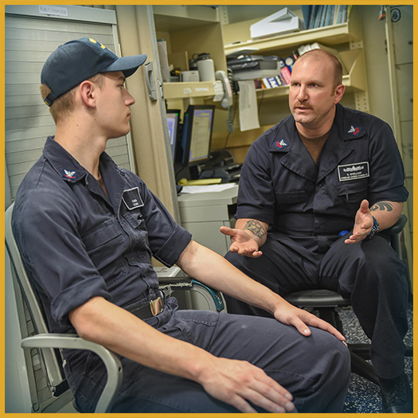
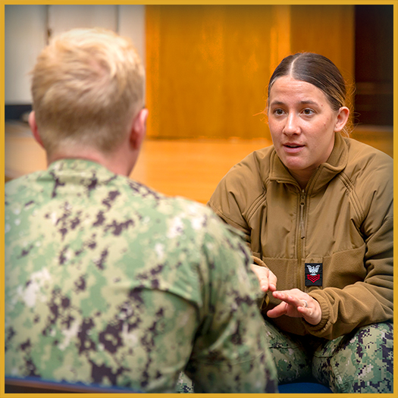
Continuous Aid
What is continuous aid?
Notes:
Facilitator Actions:
Display slide.
Discuss how graphics relate to topic.
Monitor the discussions of the Sailors.
Facilitator Content:
Discuss:
What is continuous aid?
Inform:
Continuous aid consists of the two essential components of check and coordinate.
These components are not linear and may be required several times throughout the process to help Sailors return to the green zone and recover from their stress injury.
Discuss:
What is the check process?
Inform:
The check process is a quick assessment used to determine if a fellow Sailor is in immediate danger to themselves or others.
The check process includes the following:
Assess distress level, functioning, and immediate risks.
Identify the stress zone to determine the type and level of stress injury.
Determine necessary steps and track recovery.
Key questions to ask yourself in the check process:
Is the Sailor a danger to themselves or others?
Can they regulate their thoughts, emotions, and behavior?
Is their daily performance being affected?
Discuss:
How can you check on a fellow Sailor that is experiencing a stress injury?
What should you do if a Sailor comes to you and is exhibiting signs they may be in danger?
Discuss:
What is the coordinate process?
Inform:
The coordinate process is used to coordinate additional help for Sailors in need.
The coordinate process includes the following:
Seek assistance as needed.
Identify who else should be informed or involved.
Refer for further evaluation or higher-level care.
Ensure access to necessary care and follow up.
Work with others such as family, leaders, and peers to manage the situation, provide additional resources, and facilitate recovery.
Discuss:
Have you ever assisted in providing continuous aid for a fellow Sailor?
Did you check on them regularly and provide peer-to-peer support?
When did you realize they needed help?
Did you work with your leaders to ensure the Sailor received assistance?

Slide 16

Coordination Resources (continued)
What are some resources available to support those who need additional support?
Sexual Assault Prevention
and Response
(SAPR)
Navy Sexual Harassment
Prevention and
Response Programs
Command Managed
Equal Opportunity
(CMEO)
Suicide Prevention
Uniform Code
Of Military Justice
(UCMJ)
Chaplains
Notes:
Facilitator Actions:
Display slide.
Discuss how graphic relates to topic.
Monitor the discussions of the Sailors.
Facilitator Content:
Discuss:
What are some resources available to support those who need additional support?
Inform:
Peer-to-peer support is an informal interaction between peers. However, you should be prepared to escalate treatment to the appropriate caregiver.
If the talk reveals a critical situation, you must understand when to refer to a higher level of care. If any situation comes up during the discussion and you are confused as to what to do, stop the conversation and refer the Sailor to another authority.
If they agree to seek further support, make sure to execute a warm handoff rather than simply making a proposal. Make sure you follow up with them, even if you had to give them over to someone else.
Discuss:
How do the resources displayed assist Sailors who need additional support?
Have you ever used any of these Navy resources for a fellow Sailor?
Inform:
Available resources for additional support include:
SAPR
Healthcare staff must provide immediate care and treatment to victims of sexual assault. They must also contact the Sexual Assault Response Coordinator (SARC), SAPR Victim Advocate (SAPR VA), or unit SAPR VA to ensure they receive SAPR services and submit DD Form 2910.
CMEO and Navy Sexual Harassment Prevention and Response Programs
Witnesses to harassment or unlawful discrimination must report offenses they observe to their chain of command, Command Climate Specialist (CCS), or CMEO Program Manager.
UCMJ
Personnel must report UCMJ offenses that they have observed. They are encouraged to report any infractions they become aware of.
You should report any UCMJ offenses you notice to the appropriate authorities unless doing so will incriminate you. This is referred to as self-incrimination.
Suicide Prevention:
Everyone has a responsibility to seek help for others in the event of suicide threats or behaviors. Suicides and Suicide Related Behaviors (SRBs) must be reported quickly to mobilize necessary resources and inform command and Navy-wide suicide prevention initiatives.
Chaplains
Chaplains, Religious Program Specialists (RPs), Chaplain Assistants (CAs), and contracted clergy will protect confidential communications as part of their professional duties and will not disclose the information discussed without the informed consent of the individual who made the communication.
Discuss:
What would motivate you to reach out to any of these resources for a fellow Sailor?
What would keep you from reaching out to these resources?

Slide 17
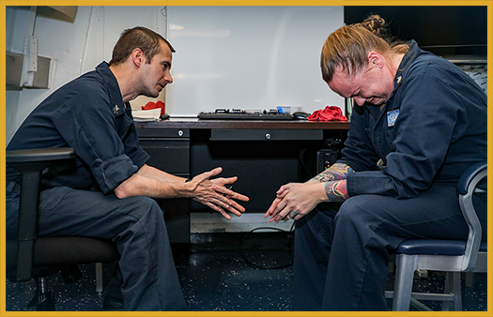
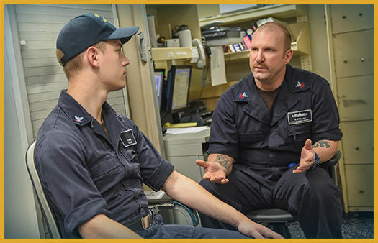

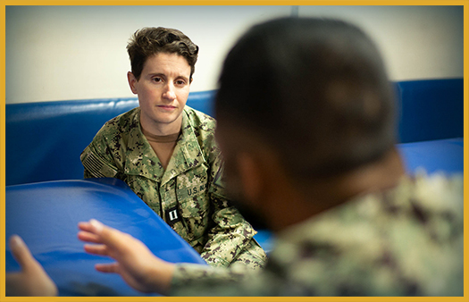
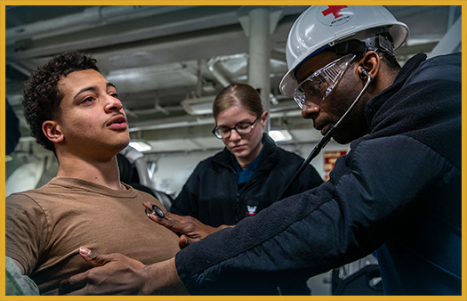
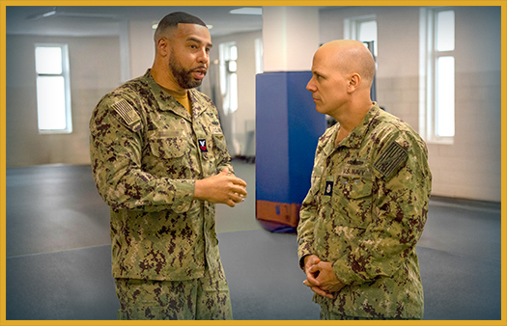
Levels of Aid Activity
Are the images displaying primary aid or secondary aid?
Notes:
Facilitator Actions:
Display slide.
Discuss how graphics relate to topic.
Monitor the discussions of the Sailors.
Time Allotted: 5 minutes
Facilitator Content:
Expected outcome: Sailors will be able to correctly identify which stage of COSFA is represented in each image.
Inform:
Explain to Sailors that they will identify the level of aid that is needed for each image on the slide.
Explain that they will have a short period of time to examine each image and then respond when prompted.
Discuss:
Start by giving a brief review of the three stages of COSFA: primary aid, secondary aid, and continuous aid.
Explain that continuous aid can happen at any time, so for this activity we are focusing on primary and secondary aid.
Ask the Sailors to review each image and give them a few seconds to determine their answer.
Ask for the correct answer and choose a volunteer to respond.
If there is any confusion or disagreement, discuss before moving on to the next image.
Continue until all six images have been discussed.
The answers left to right, top to bottom are: 1. Primary, 2. Secondary, 3. Secondary, 4. Secondary, 5. Primary, 6. Secondary.

Slide 18

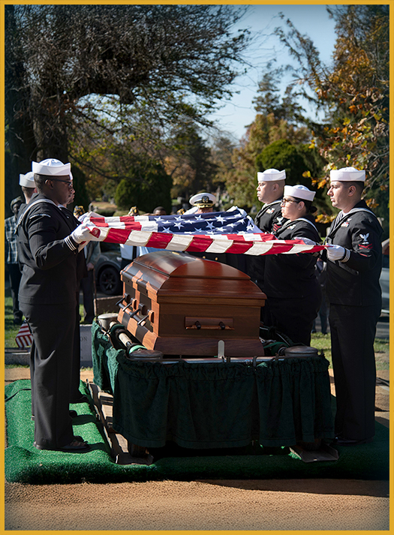
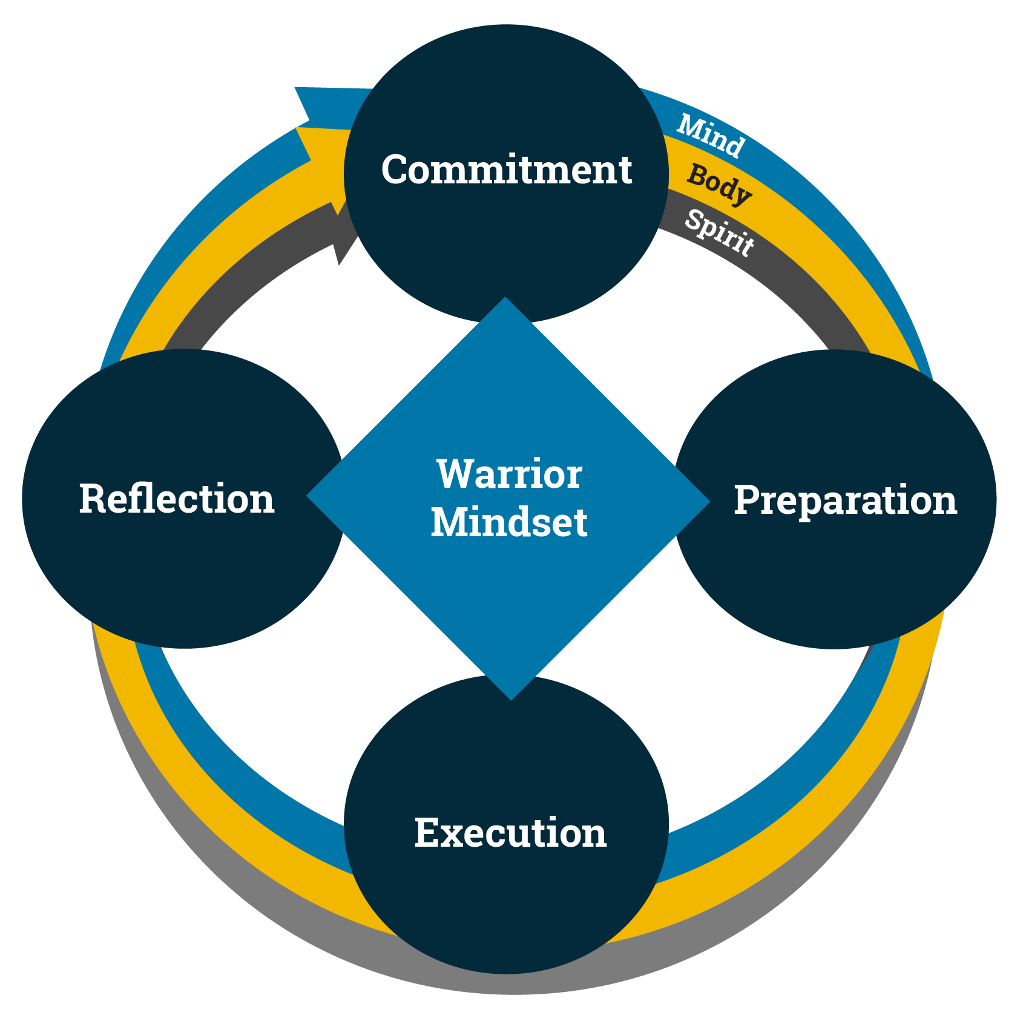
COSFA and the Warrior Mindset (continued)
Notes:
Facilitator Actions:
Display slide.
Discuss how graphics relate to topic.
Monitor the discussions of the Sailors.
Facilitator Content:
Discuss:
How does COSFA relate to the Warrior Mindset?
Inform:
The Warrior Mindset represents a peak performance framework that empowers Sailors to consistently excel. When stress injuries compromise this mental foundation, COSFA offers a pathway to recovery and restoration.
Discuss:
What can you do to help fellow Sailors get back on the path to peak performance?

Slide 19

Call to Action
Be prepared to recognize, respond to, and manage stress in any environment!
Notes:
Facilitator Actions:
Display slide.
Review topics discussed and ask if there are any questions.
Check Sailor comprehension by providing review questions and/or problems.
Discuss how the call to action supports and encourages Sailors’ post training.
Relate call to action to Warrior Toughness.
Facilitator Content: N/A

Slide 20
References
Tools and Resources
https://www.netc.navy.mil/Warrior-Toughness/
Warrior Toughness Placemat
Notes:
Facilitator Actions:
Display slide.
Facilitator Content:
Inform:
Identify tools.
Identify resources.

Slide 21
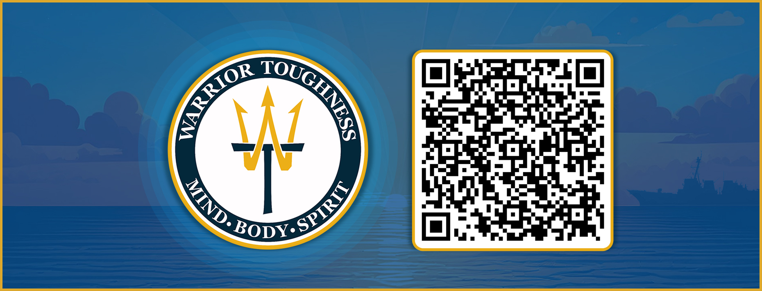
Warrior Toughness QR Code
Notes:
Facilitator Actions:
Display slide.
Facilitator Content:
Inform:
Identify Warrior Toughness QR code.

Slide 22
Glossary
Glossary
Acronym | Term
CA | Chaplain Assistant
CCS | Command Climate Specialist
CMEO | Command Managed Equal Opportunity
COSFA | Combat and Operational Stress First Aid
OSCAR | Observe, State, Clarify, Ask, Respond
RP | Religious Program Specialist
SAPR | Sexual Assault Prevention and Response
SAPR VA | SAPR Victim Advocate
Notes:
Facilitator Actions:
Display slide.
Facilitator Content: N/A

Slide 23
Glossary (continued)
Glossary
Acronym | Term
SARC | Sexual Assault Response Coordinator
SRB | Suicide Related Behavior
UCMJ | Uniform Code of Military Justice
WT | Warrior Toughness
Notes:
Facilitator Actions:
Display slide.
Facilitator Content: N/A

